Slide 1
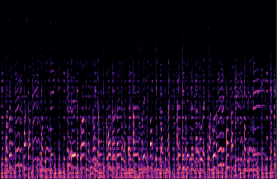
128 x 128
1 x 1
….
512 features
Fully Connected (ReLU)
1 x 1
….
128 features
Global Average Pooling
Drop Out (0.5)
VGG16
Fully Connected (Softmax)
1 x 1
….
10 features
Dense Layer
4 x 4
….
512 features

